Slide 1
🩺 How healthy is your team?
Si Jobling
From Code to Command
12 September 2024

Slide 2

WHOAMI_
Engineering Manager @ Rightmove, former Delivery Lead @ AliPay & Agile Delivery Manager @ ASOS
Leading teams of software engineers since 2017 using engineering background to relate
Passionate about collaboration, communication and culture across all disciplines

Slide 3
What are Team Health Checks? 💖
“Team Health Checks can help provide insight into a wide range of topics that can have a significant impact on employee happiness and satisfaction.
“It’s an opportunity to get visibility into what’s going on in a team’s context or across a group of teams, at a particular moment in time.

Slide 4
Common challenges in team work
Lack of introspection as a work ethic
Emotional unawareness of yourself and peers
There’s no vernacular for articulating how we feel in ebbs and flows of work cycles
Tech is one of the most challenging & dominant industries to facilitate this (ironically too focused on measured deliverables, neglecting healthy work)
People have a slender grasp on GOOD coaching
Existing frameworks are complex, deep, taxing and slow

Slide 5
When was the last time you were brutally honest about your work?
Talk to your neighbours as if they’re your team mates.

Slide 6
🎗️ How can we encourage teams to be more self-aware?

Slide 7
🧑‍🤝‍🧑 How can we create a psychologically-safe space for teams to openly share with each other?

Slide 8
💗 How can we get a regular pulse of team health?

Slide 9
What already exists?
Notes:
These are proven models and frameworks based on research, practice and continued use across many industries.

Slide 10
Johari Window
Known to others
Open Area
Blind Spot
Hidden Area
Unknown
Popular framework used in education and business leadership to understand relationships in teams.
Aim for the top-left Open quadrant but use other quadrants to learn about yourself and team mates.
Known to self
Not known to self
Joseph Luft and Harrington Ingham (1955)
Not known to others
Notes:
Designed to help people better understand their relationship with themselves and others
Regularly referenced in education and business leadership
Open Arena: What you know about yourself and is known by others in a team or group
Blind Spot: Things you don’t know about yourself – but others DO know
Hidden Area: What you know about yourself – but others DON’T know
Unknown: What is unknown about you BY you AND others

Slide 11
The Fearless Organisation
High psychological safety
Learning Zone
Apathy Zone
Anxiety Zone
Comfort Zone
Creating psychological safety in the workplace for learning, innovation and growth.
Use as a conversation starter to understand how safe teams are currently and how to aim for the top-right Learning quadrant.
Low standards
High standards
Professor Amy C Edmondson, Harvard Business School (2018)
Low psychological safety
Notes:
Popular research by Professor Amy Edmondson who initially coined the term about TEAM psychological safety.
Plenty evidence to suggest working towards the Learning Zone forms the strongest teams

Slide 12
Five dysfunctions of a team
5. Inattention to results
4. Avoidance of accountability
3. Lack of commitment
2. Fear of conflict
1. Absence of trust
Dysfunction #1: Absence of trust
Dysfunction #2: Fear of conflict
Dysfunction #3: Lack of commitment
Dysfunction #4: Avoidance of accountability
Dysfunction #5: Inattention to results
Patrick Lencioni, 2002
Notes:
DYSFUNCTION #1: ABSENCE OF TRUST The fear of being vulnerable with team members prevents building of trust within the team.
DYSFUNCTION #2: FEAR OF CONFLICT The desire to preserve artificial harmony stifles the occurrence of productive, ideological conflict.
DYSFUNCTION #3: LACK OF COMMITMENT The lack of clarity or buy-in prevents team members from making decisions they will stick to.
DYSFUNCTION #4: AVOIDANCE OF ACCOUNTABILITY The need to avoid interpersonal discomfort prevents team members from holding one another accountable for their behaviours and performance.
DYSFUNCTION #5: INATTENTION TO RESULTS The pursuit of individual goals and personal status erodes the focus on collective success.

Slide 13
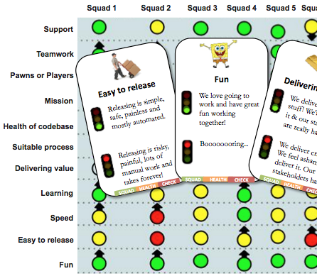
Spotify Squad Health Check
🚦 Simple traffic light system across comprehensive list of 11 factors.
🕐 Requires 1-2 hours to go through all topics properly.
🗓️ Generally referenced every 3-6 months across multiple teams.
Spotify Engineering Blog (Sep 2014) https://engineering.atspotify.com/2014/09/squad-health-check-model/

Slide 14
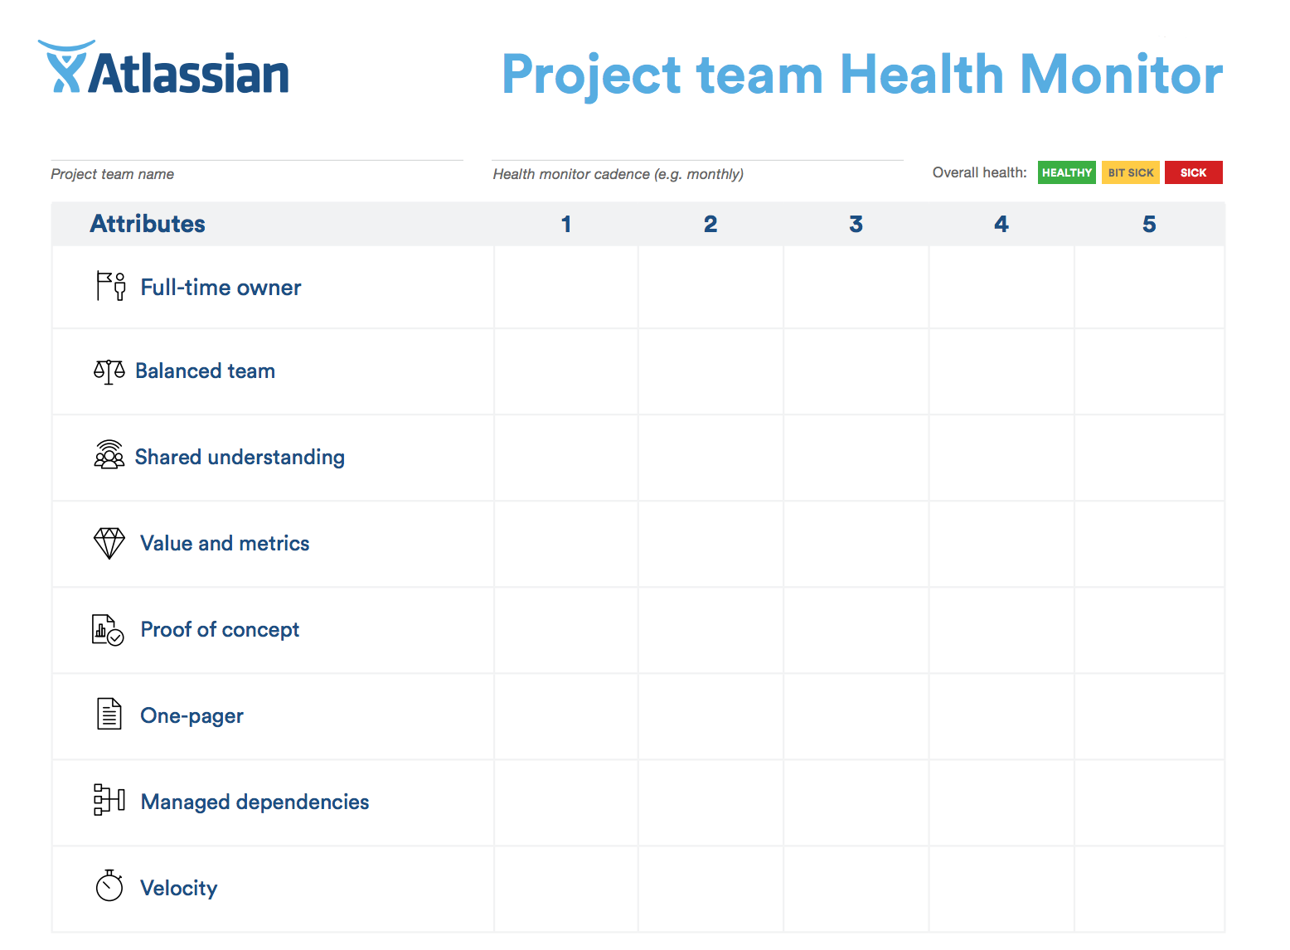
Atlassian Health Monitor
🎱 8 factors about team interactions and awareness
🕜 Requires 90 minutes to facilitate deep discussion
👥 More focused on team culture and ways of working
Atlassian Team Playbook, 2017 https://www.atlassian.com/team-playbook/health-monitor

Slide 15
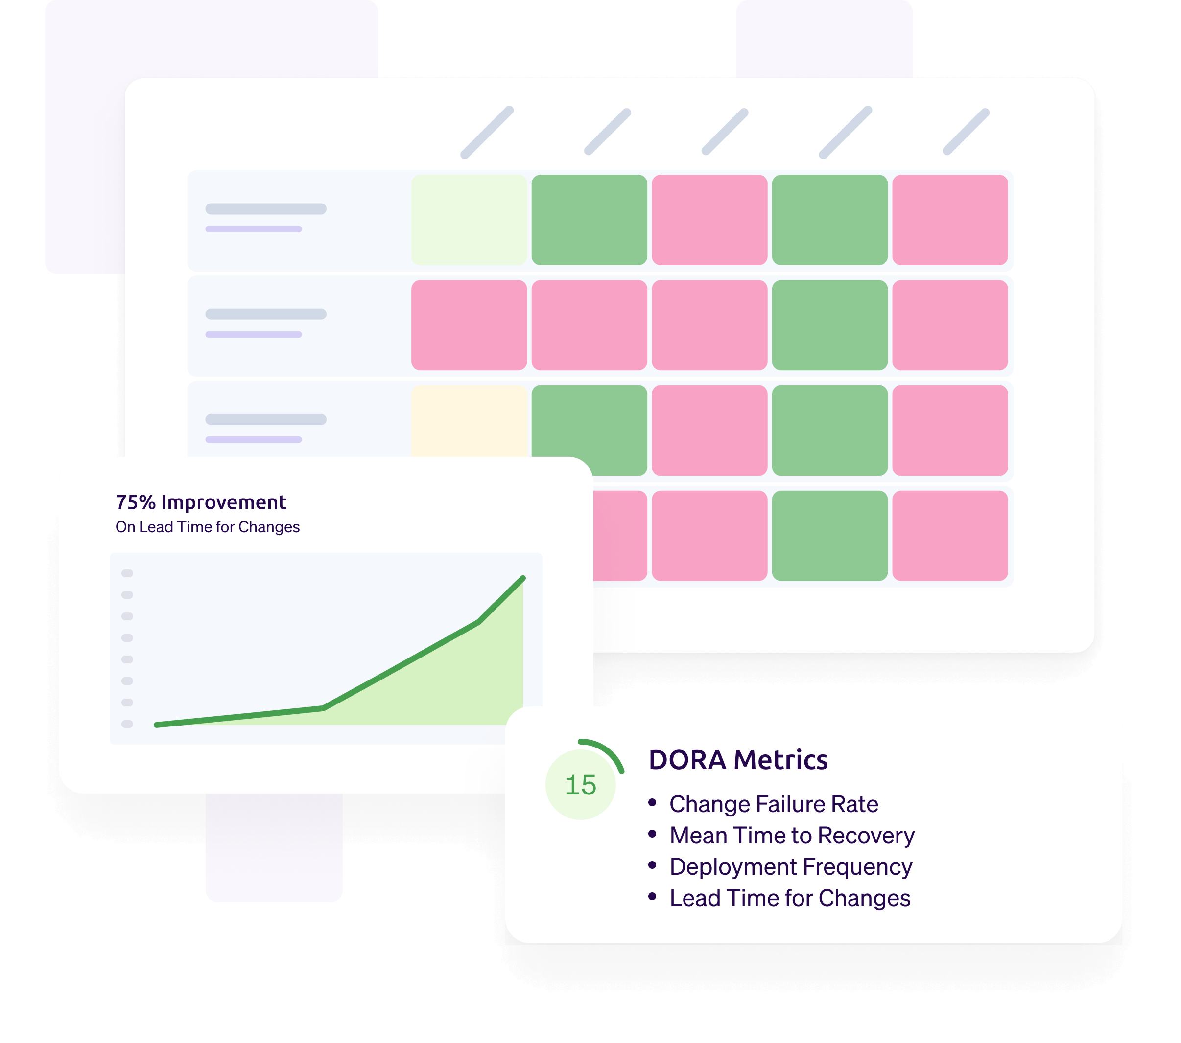
Google DORA
4️⃣ Four key metrics to measure devops performance
🧑‍💻 Tech-delivery specific topics focused on deployment frequency, lead time for changes, change failure rate and time to restore service.
📊 Regular checkpoints closer aligned to real-time metrics.
Google Cloud DevOps Research & Assessment (circa 2020) https://dora.dev/

Slide 16
Time for PETALS

Slide 17
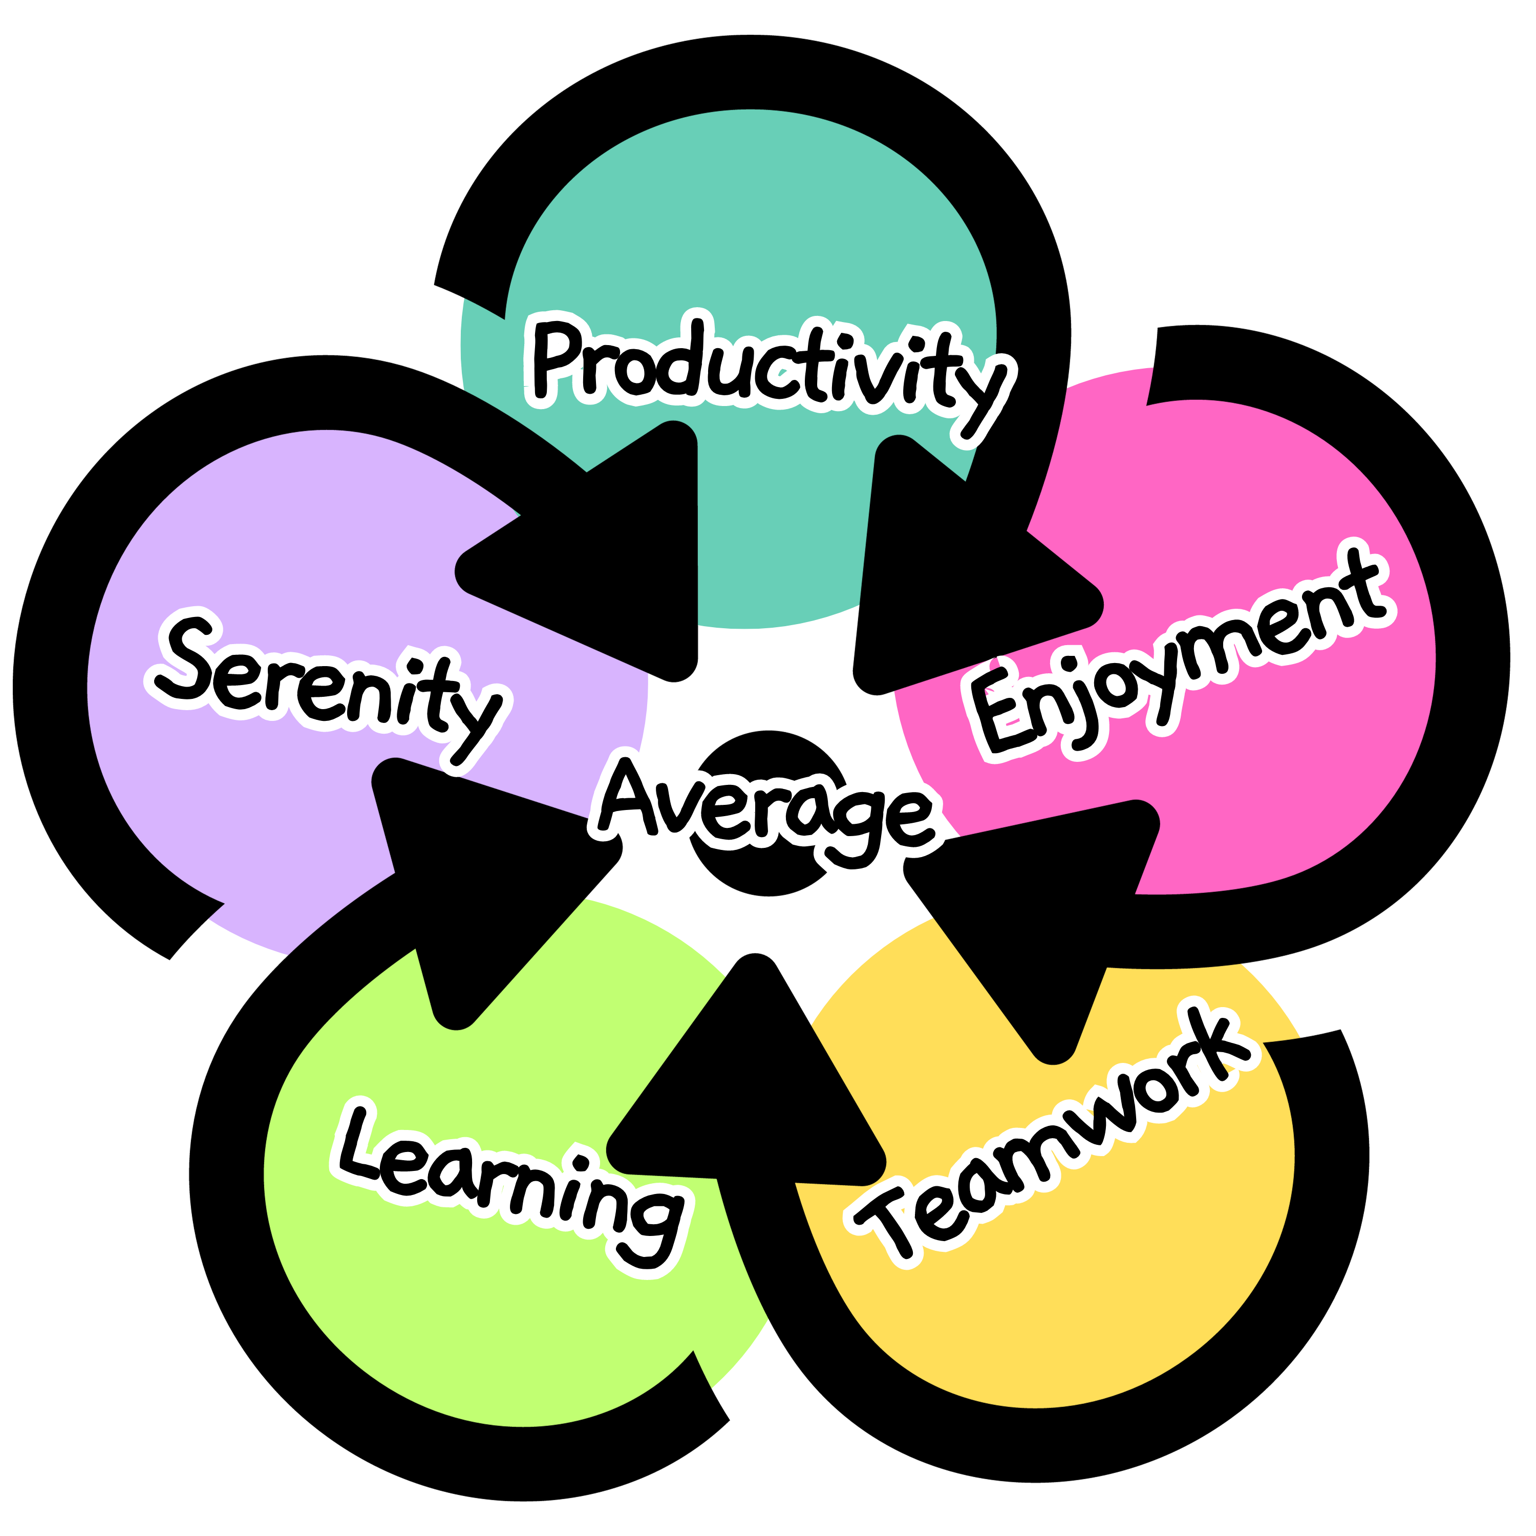
Acronym for 5 common factors of healthy teams
Productivity
Enjoyment
Teamwork
(Average)
Learning
Serenity

Slide 18
Why these five?
Productivity | Because we want to get things done | How much have you achieved or delivered?
Enjoyment | Because we want to feel a sense of satisfaction | How much did you enjoy doing the work?
Teamwork | Because collaboration often brings better quality | How much work did you do independently or with peers?
Learning | Because our brains constantly need challenging | How much did you learn on the job (or off)?
Serenity | Because we can only sustain limited amounts of structural tension | How high did your stress levels get and for how long?
Notes:
Productivity often measured by work items complete but all the non-measurables (discussions, workshops etc) also matter
Enjoyment could be through the work you do or even social time with your team (or home)
Teamwork could be through pairing, mobbing, knowledge sharing, supporti…
Learning could also be knowledge sharing, understanding problems better, finding new solutions, getting to know team mates more
Serenity is the opposite to STRESS but some stress can be useful in the workplace - Structural tension is the gap between the person’s vision and reality

Slide 19
Visualise the data
Productivity
5.0
✍️ Ask all team members to quickly rate each factor out of 5.
🧮 Calculate overall and factor averages from all team contributions.
🚥 Colour-code live results with traditional red-amber-green spectrum in flower arrangement.
Serenity
1.0
Enjoyment
3.0
3.2
Average
4.0
Learning
3.0
Teamwork

Slide 20
Now discuss!
📈 Observe overall averages, trends over time and outliers.
🗣️ Teams are encouraged to talk through individual scores with personal reasons but only in a psychologically-safe space.
📝 Note down actions, improvement areas and breakout discussions for follow-up.
👥 Scores are subjective and arbitrary. They are not hard measures but conversation starters.

Slide 21
Who's using PETALS?

Slide 22
It all started in lockdown…
Returned to ASOS in lockdown
Personal retro every Friday evening
First team retro with MS Forms
More teams joined the TEAM HEALTH movement
Internal web app launched
PETALS.team website + newsletter
Web app prototype
Snapshots + public speaking
Web app v2

Slide 23
Demand is growing…
60+ Linkedin community members
70+ known active teams
150+ newsletter subscribers

Slide 24




















Interest is growing…

Slide 25
Now what?

Slide 26

Introduce PETALS to your team
Identify a suitable team meeting or platform to suggest something new.
Talk your team through the framework (or invite me along).
Facilitate a discussion using our app https://petals.team/matchtech
Explore your team snapshot ratings, collectively and individually.
Agree on the next steps and follow-up sessions.

Slide 27
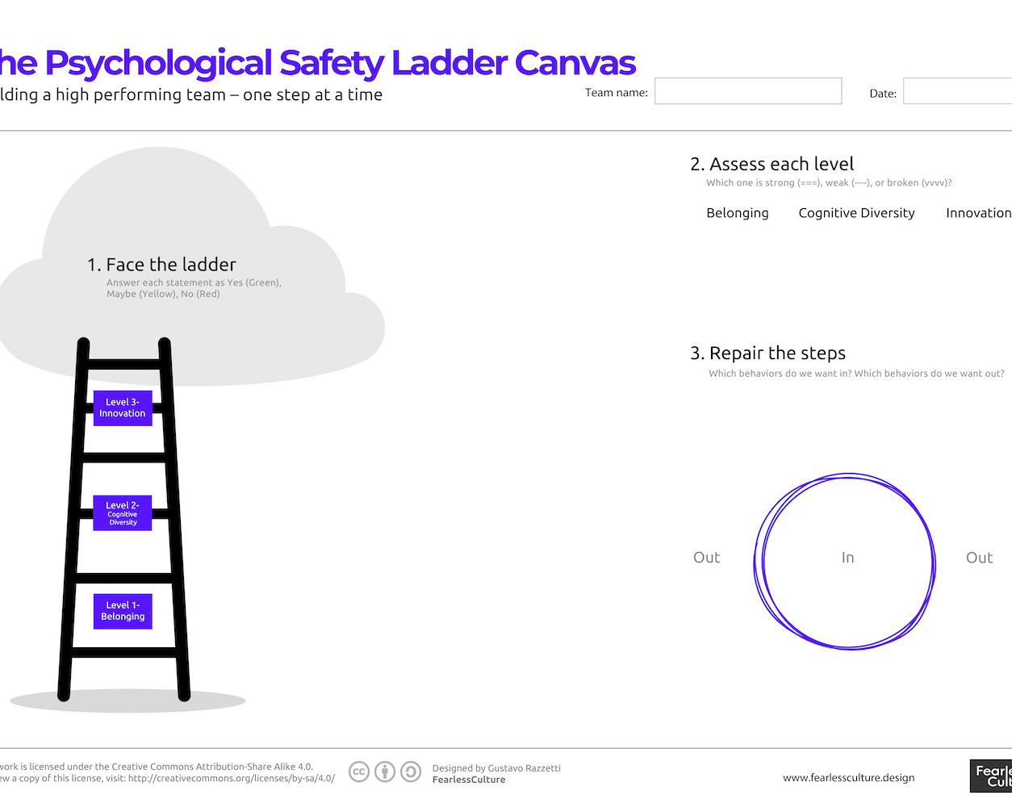
The psychological safety ladder
Visual tool by Gustavo Razzetti to create a safe team culture – one step at a time.
Belonging
Cognitive Diversity
Innovation
https://www.fearlessculture.design/blog-posts/the-psychological-safety-ladder-canvas

Slide 28
Questions?
Ask now or reach out
si@petals.team
@sijobling on most socials
petals.team

